Slide 1
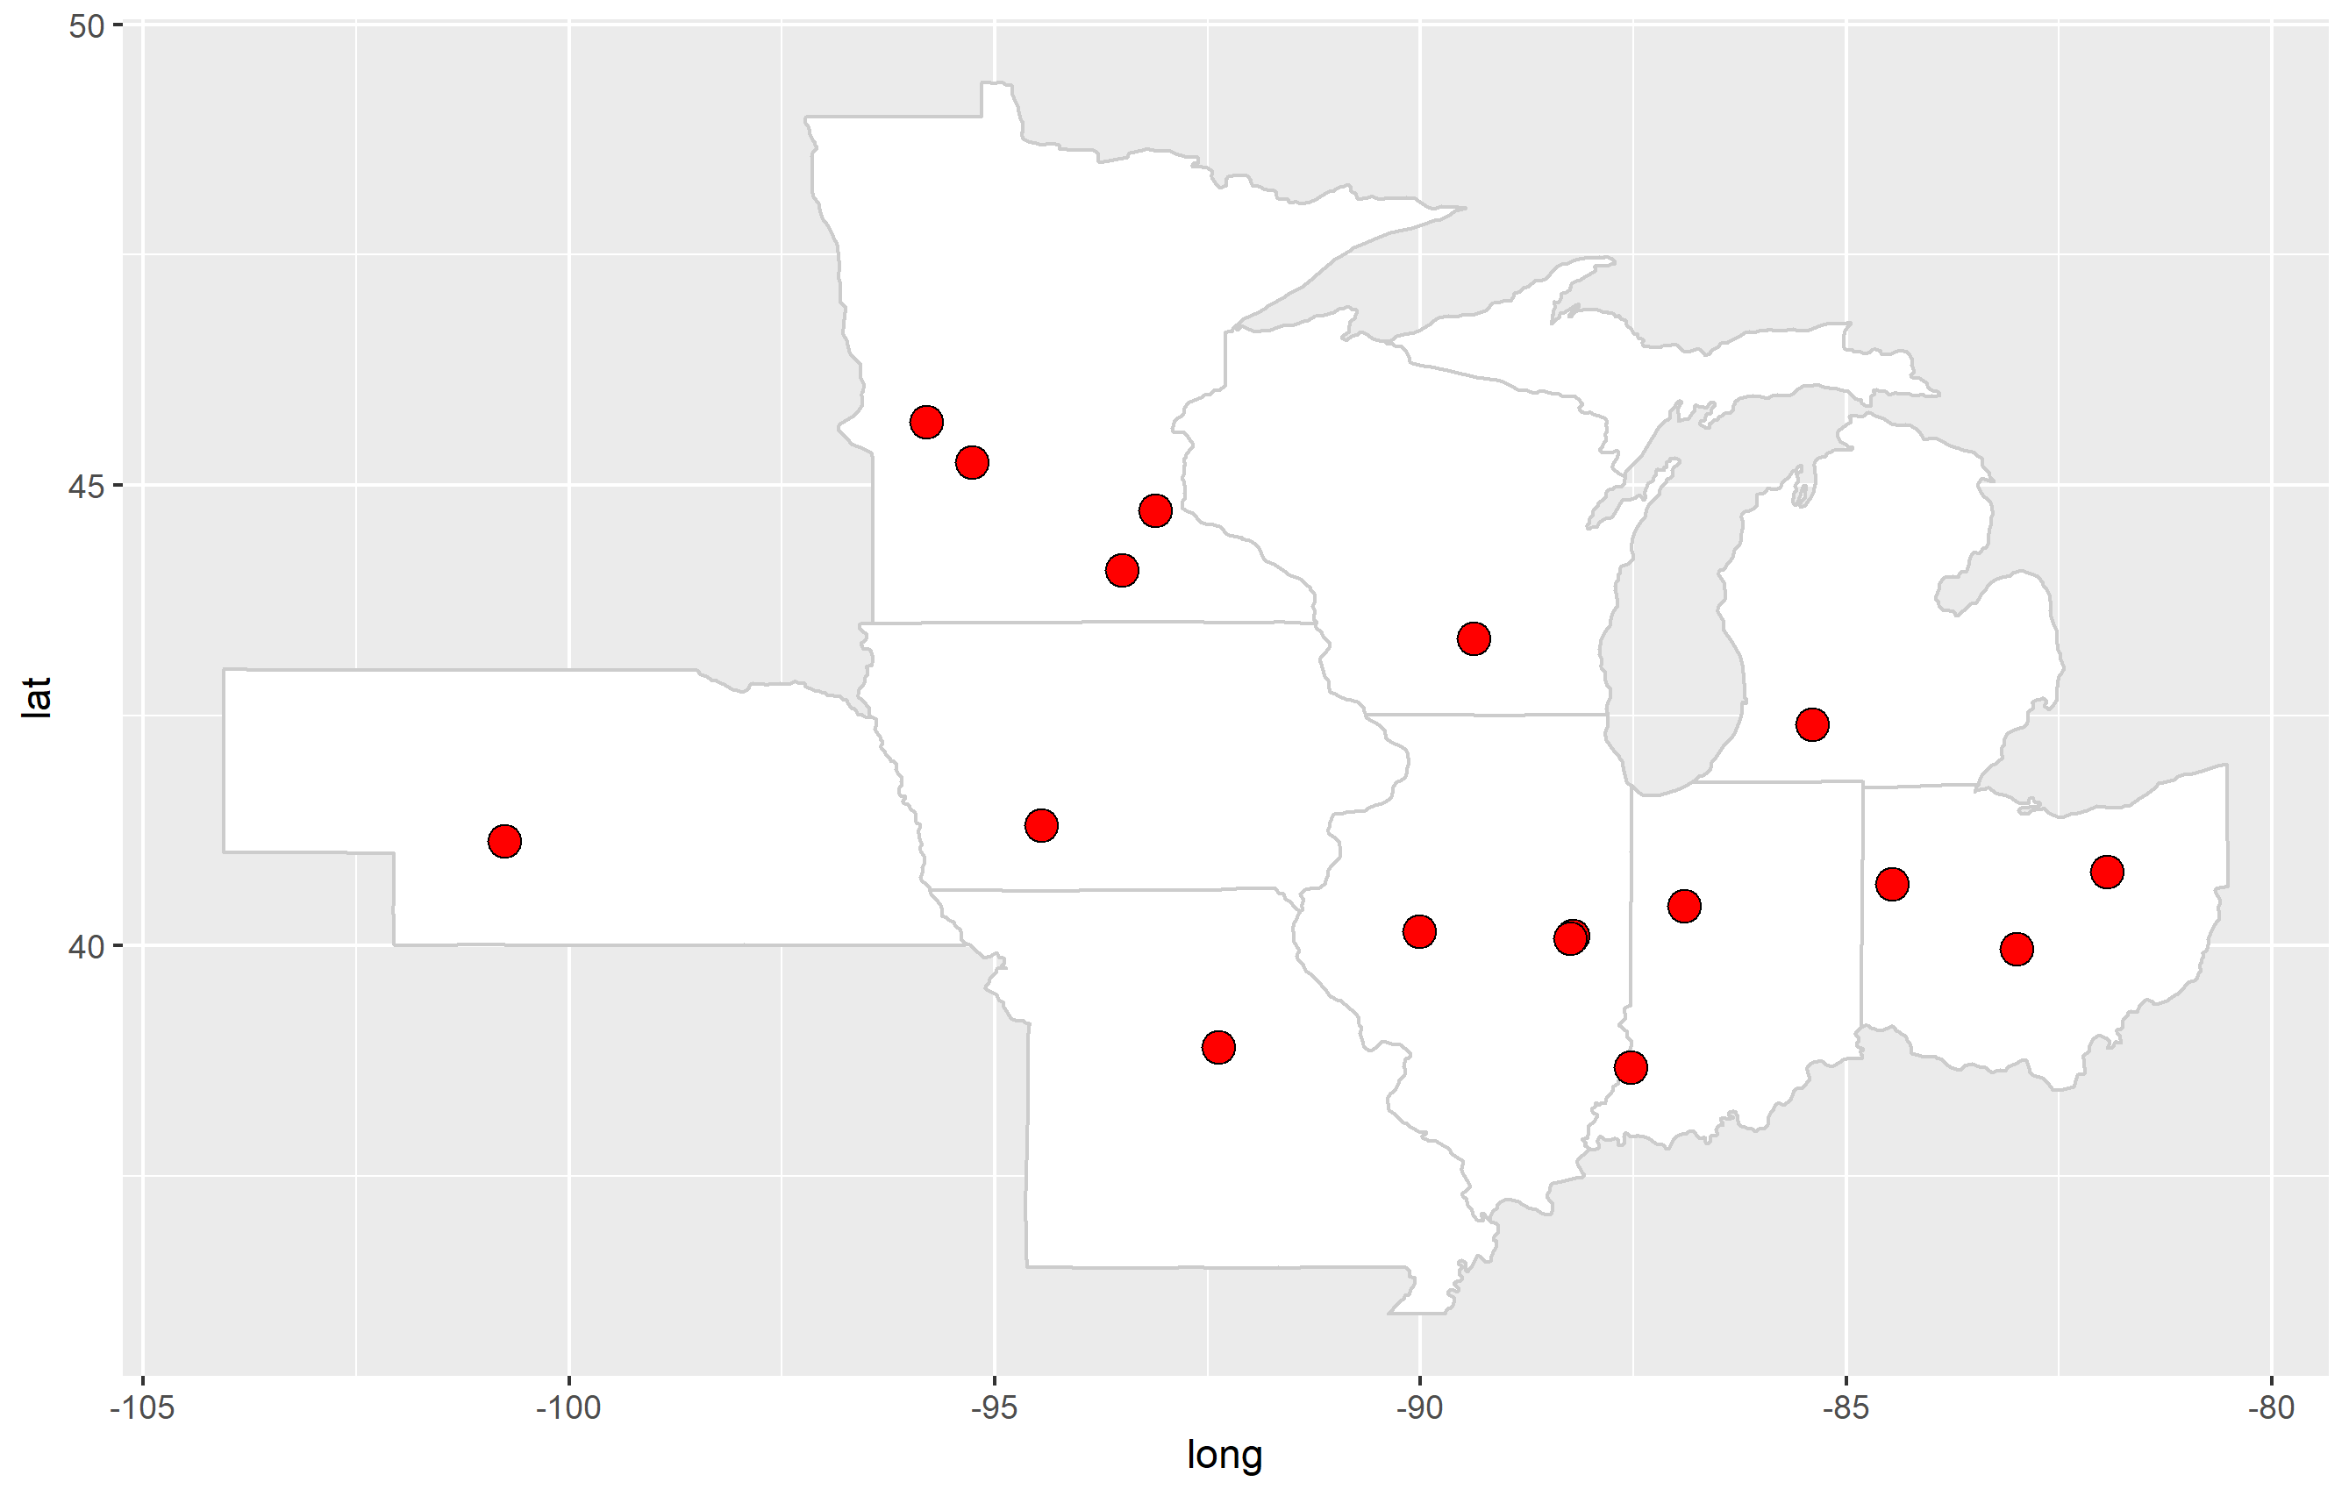
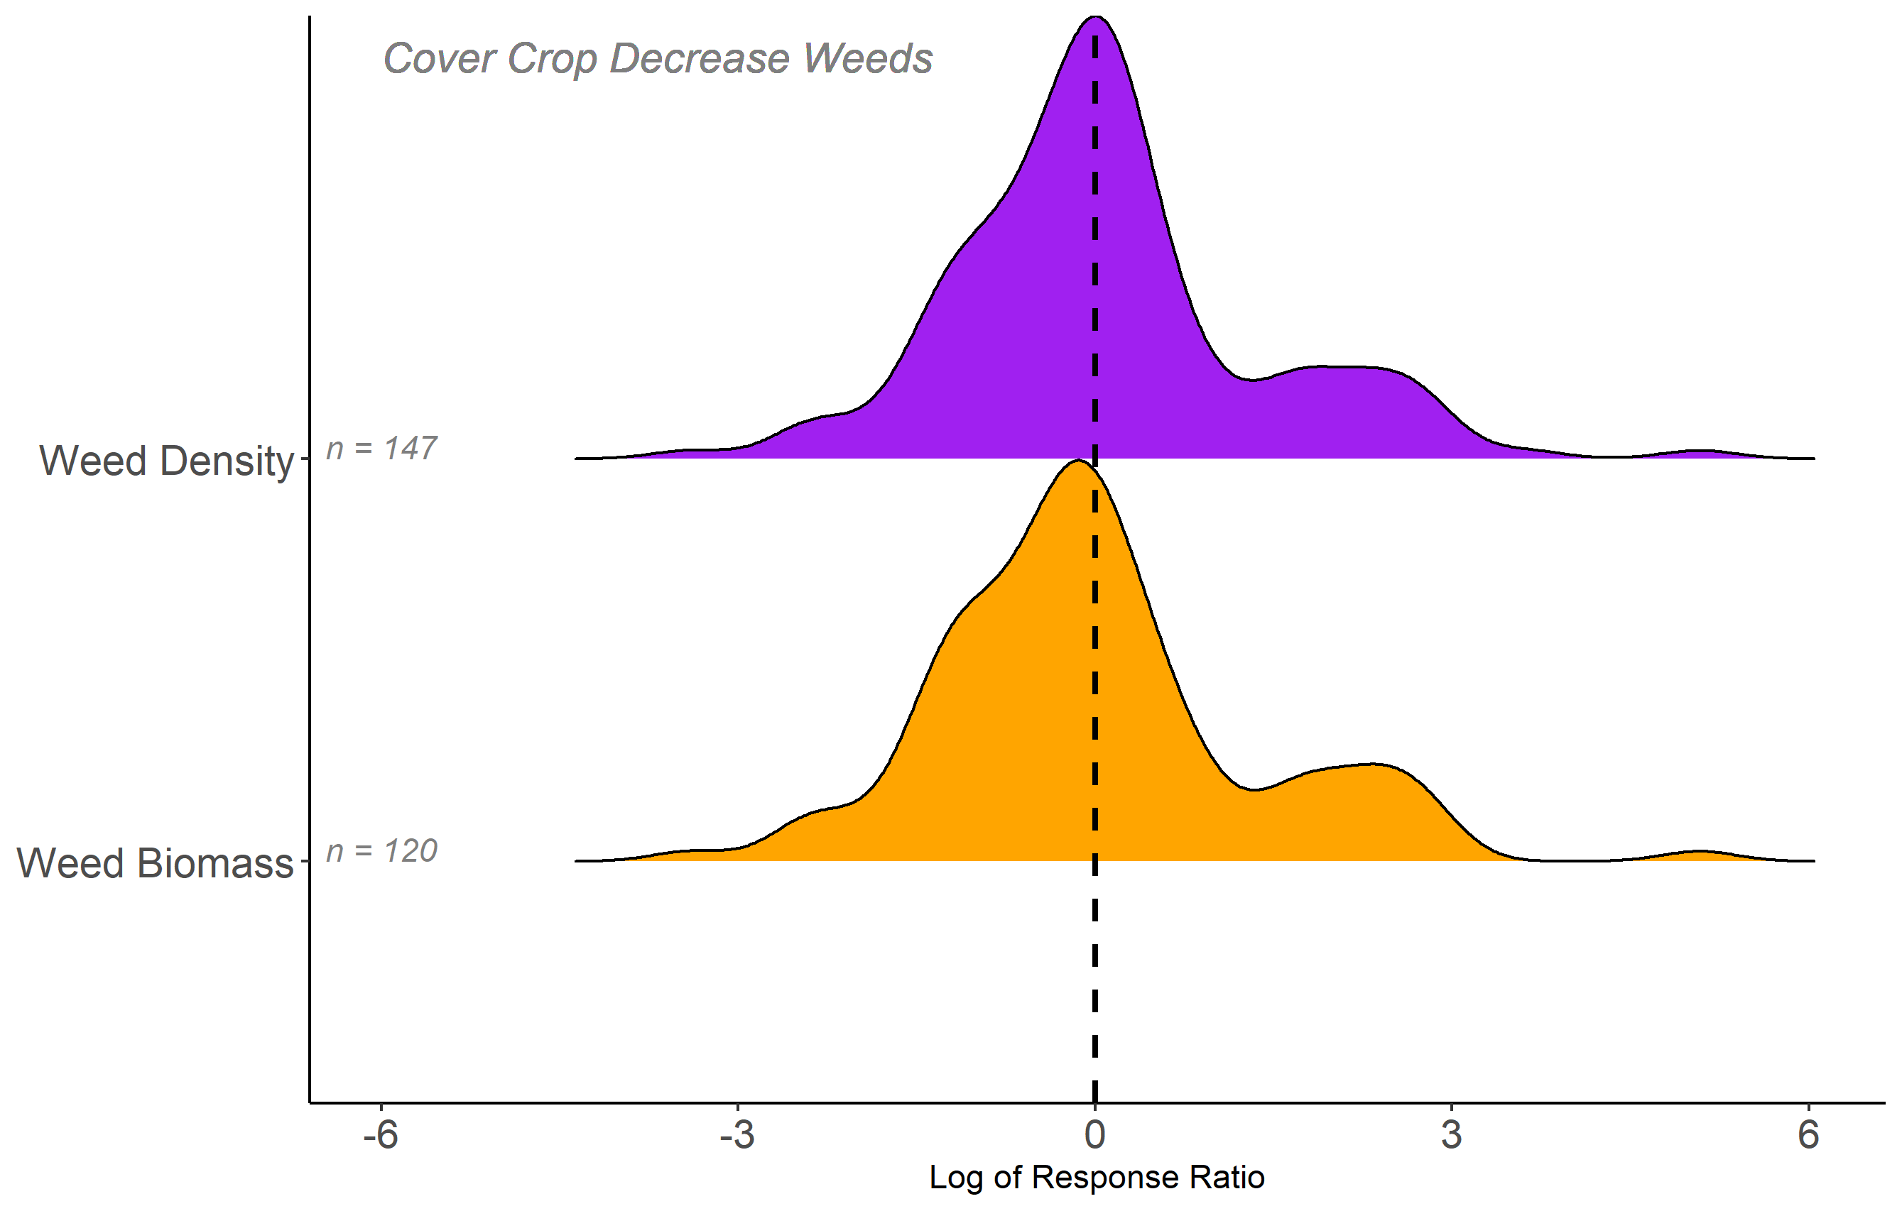
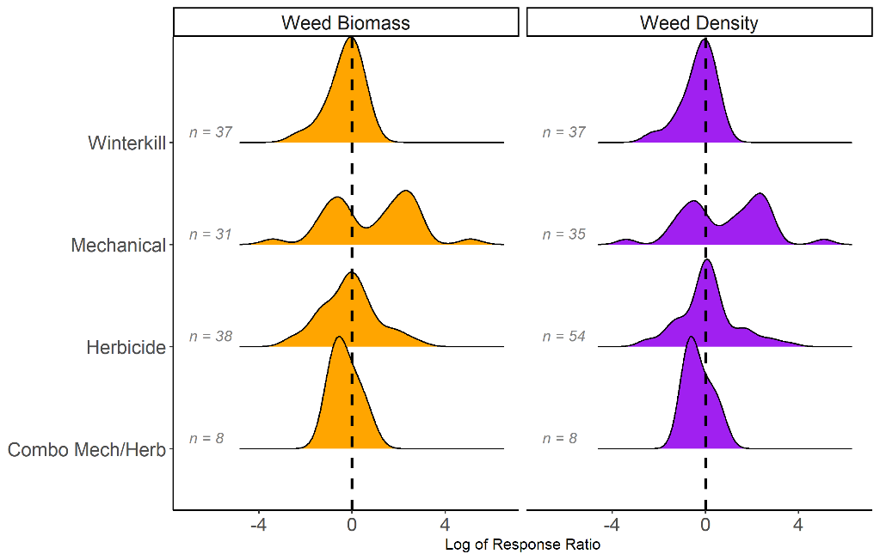
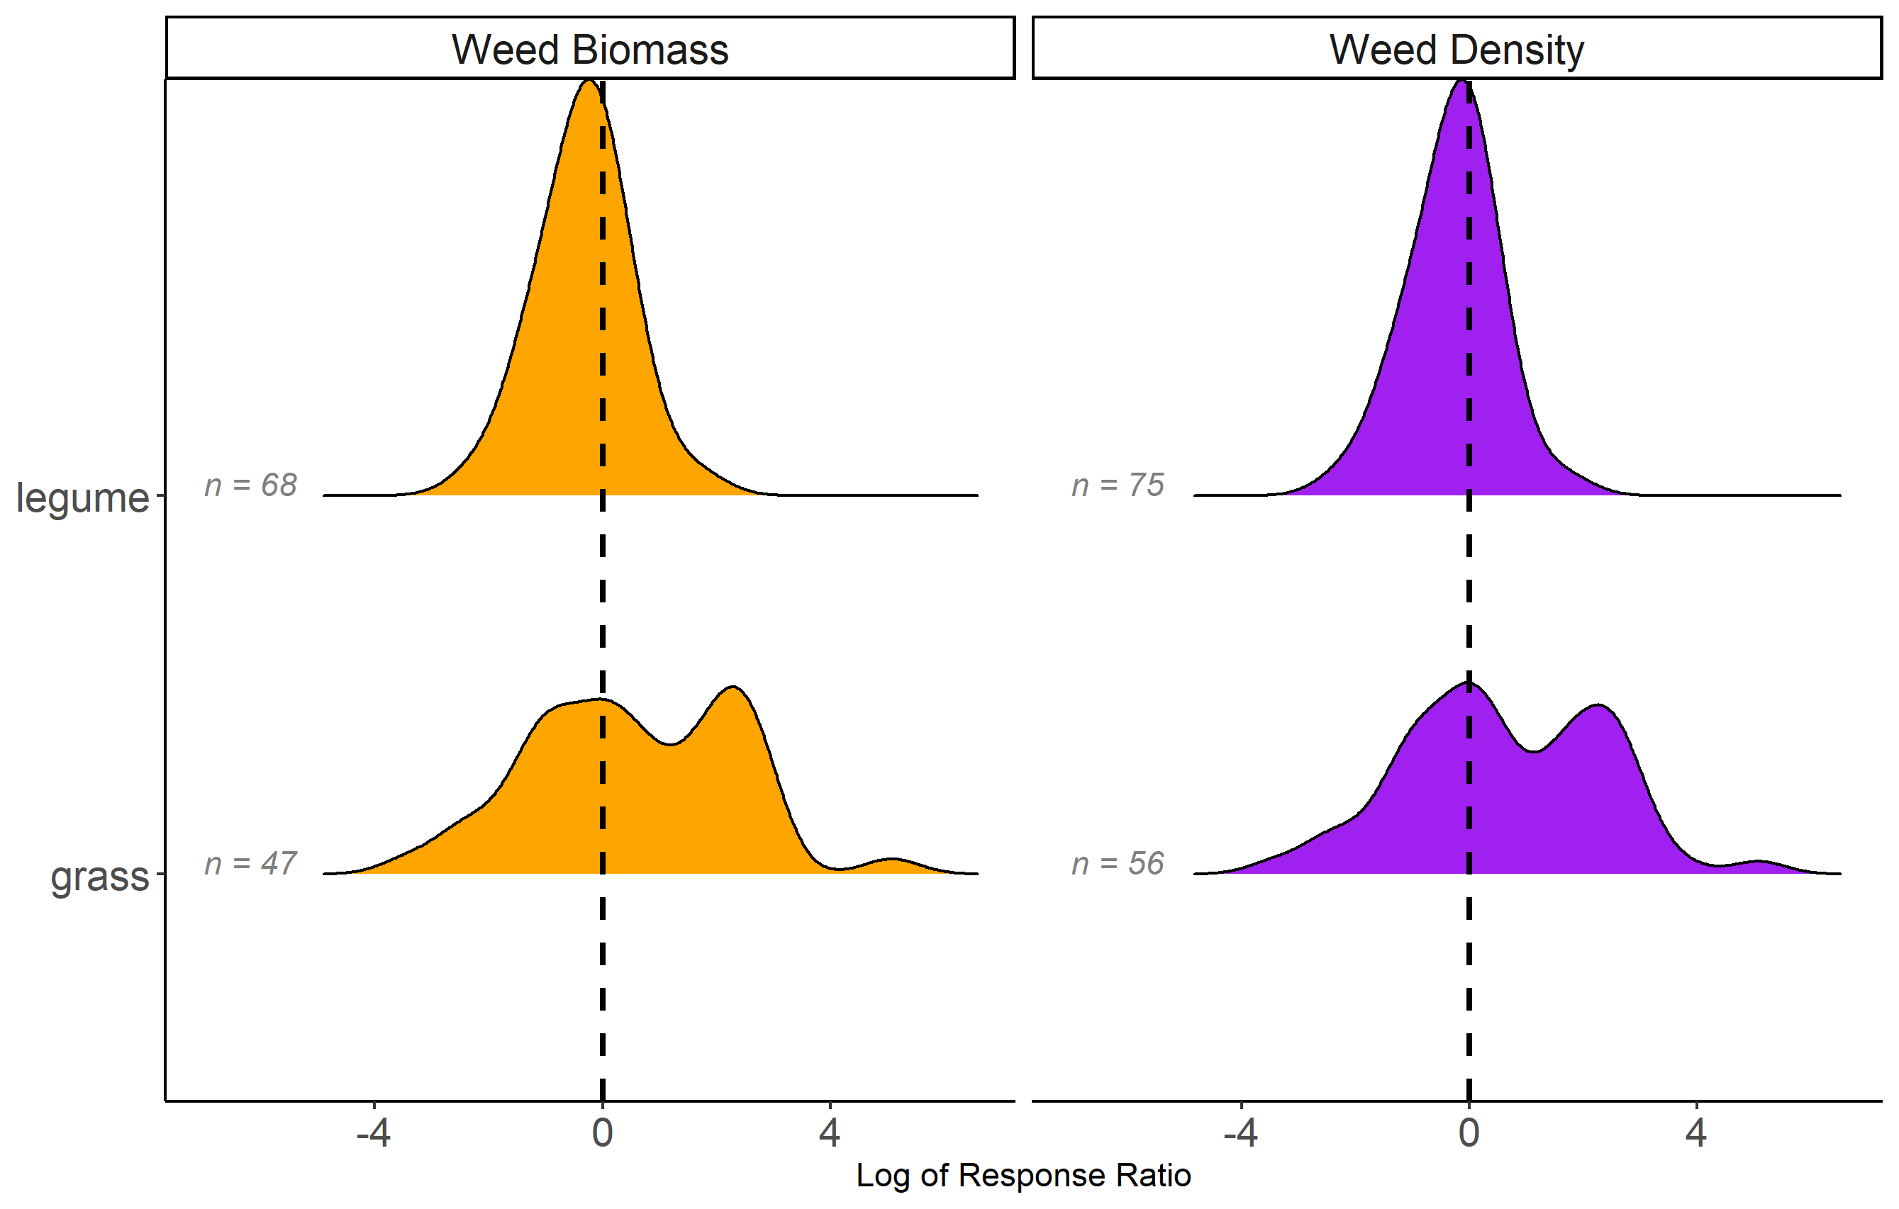
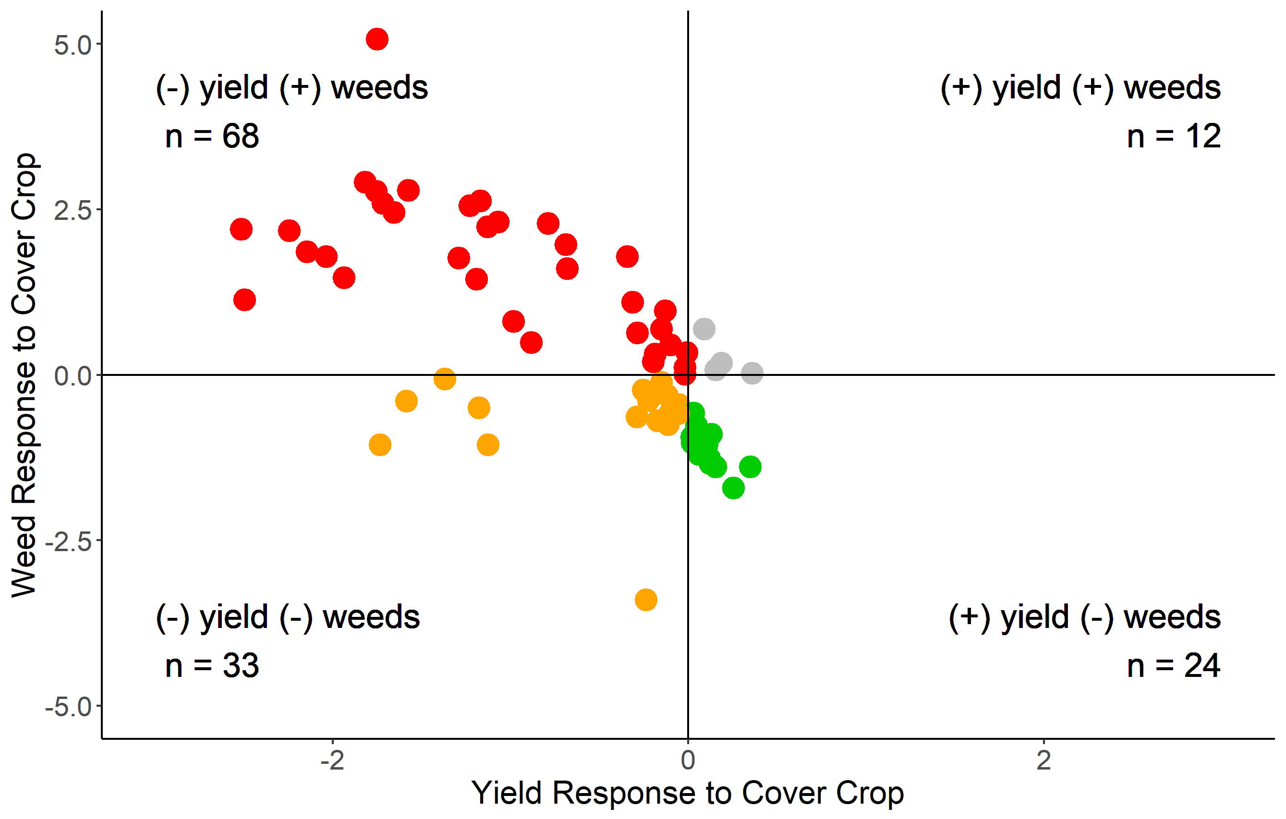
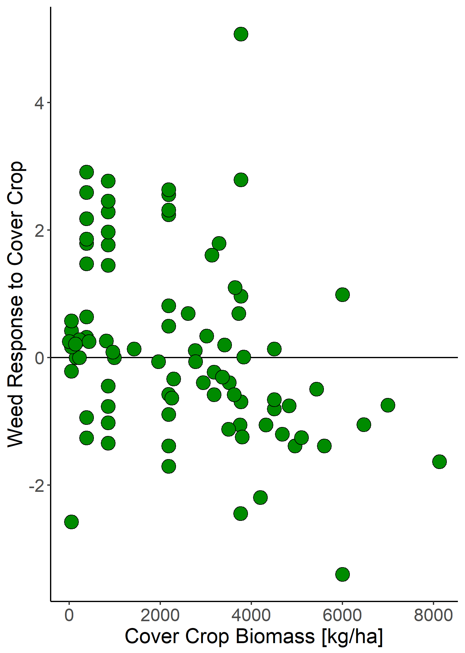
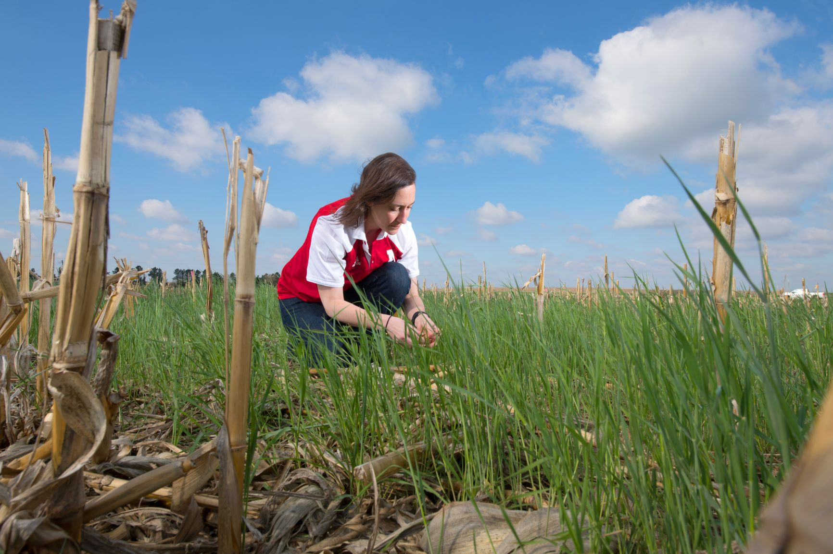
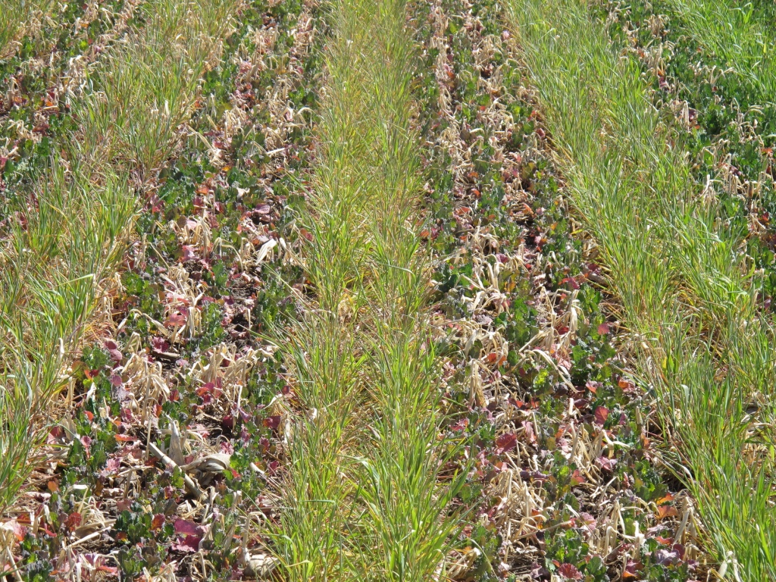


Do winter cover crops suppress weeds in Midwestern corn- and soybean-based systems?
A meta-analysis
Andrea Basche¹, David Weisberger², Virginia Nichols², Alisha Bower³, Chris Wilbeck³, Sarah Carlson³
1. University of Nebraska-Lincoln, Department of Agronomy and Horticulture, Lincoln, NE
2. Iowa State University, Department of Agronomy, Ames, IA
3. Practical Farmers of Iowa, Ames, IA
Rationale
Results
The Midwestern U.S. has seen a modest increase in winter cover crop use over the past 10 years. However to reach water quality goals, it is estimated that adoption of cover crops will need to scale from 5% to more than 50% of cropland acres in this region. At the same time, their use may aid in reducing herbicide costs and in providing an alternative strategy for managing herbicide resistant weeds, both important cost savings that improve short-term economics. Presently, the degree to which cover crop type, fall planting date and spring termination method affect weed management is not well understood. Further, the quantity of cover crop biomass needed for a significant reduction in weeds is uncertain. To address these questions, we conducted a meta-analysis to quantify the effects of winter cover crops, and their management, on weeds. We included peer-reviewed studies in our database if they: (1) Were located within one of the major corn producing Midwestern states*; (2) Grew a fall seeded cover crop before corn or soybean; and (3) Measured and reported weed biomass or weed density.
.
Locations of experiments (top left), years of publication (top right) and meta-data (bottom). *Only Illinois, Indiana, Iowa, Kansas, Michigan, Minnesota, Missouri, Nebraska, North Dakota, Ohio, South Dakota, and Wisconsin were potentially included because we were concerned with the continuous Corn Belt states with the greatest number of corn and soybean acres.
State | Year | Cover crop species | Corn or soybean | Authors
OH | 1993 | vetch | corn | Hoffman et al.
MI | 2001 | clover, medic | corn | Fisk et al.
IL | 2002 | vetch | corn | Czapar et al.
OH | 2003 | wheat, vetch | corn, soybean | Gallagher et al.
MN | 2005 | rye | soybean | DeBruin et al.
IL | 2010 | rye, vetch | soybean | Davis et al.
WI | 2011 | rye | soybean | Bernstein et al.
IA | 2012 | mixes | corn, soybean | Delate et al.
MI | 2012 | rye/vetch, vetch | …* | Hayden et al.
IN | 2012 | wheat, ryegrass | corn, soybean | Mock et al.
MN | 2013 | rye | soybean | Forcella et al.
MN | 2016 | radish | corn | Gieske et al.
MO | 2017 | mixes* | soybean | Cornelius and Bradley
IL | 2017 | radish, canola, rye | soybean | Crawford et al.
NE | 2018 | rye | …* | Werle et al.
Above: Response ratios represent the natural log of weeds (biomass or density) Cover crops decreased weed density in 48% of response ratios by a mean value of x (standard error x). Cover crops decreased weed biomass in 55% of response ratios by a mean value of 36% (standard error 82%).
Below: Winterkill, herbicide and dual methods of cover crop termination were more effective at suppressing weeds with cover crops. Experiments with grass cover crops were skewed by one study (DeBruin et al.) and one location with excessive weeds.
Objectives: 1) Quantify weed control from experiments in corn-soybean cropping systems in the Corn Belt using fall planted cover crops; 2) Identify cover crop management practices required to achieve optimal weed control
MAYBE CUT THIS OUT AND MAKE THE OUTSTANDING QUESTIONS BIGGER
Methods
Records identified through Web of Science keyword search = 676
Keyword search string: (weed* AND ("cover crop*" OR "green manure" OR "catch crop*") AND ("corn" OR "maize" OR "soybean*"))
(left) When experiments included yields we found that cover crops represented “win-win” scenarios 18% of the time where weeds were reduced and yields were increased. Overall yields were increased 31% of the time in our database.
(right) Greater levels of cover crop biomass tended to have a greater impact on weed control, although that was not always the case. Experiments with cover crop biomass >4000 kg/ha had consistent reductions in weeds.
Records excluded = 456
Most common reason was that studies were clearly not relevant based on abstract/title
Full text articles screened for eligibility = 220
Full text articles excluded = 131 + x
Most common reasons: weeds were not measured; studies were not located in Corn Belt States*; did not include cropping systems or experimental design that would allow for a true control to experimental comparison; grew a spring vs. fall seeded cover crop
Articles included in qualitative synthesis ~ 16 review articles
Questions:
Biomass?
Herbicide interactions/efficacy
Cover crop creating a more favorable environment
Winterkill versus overwintering – radishes should decrease weeds but legumes might
Articles included in quantitative synthesis = 15 to date, ~x left for screening
Andrea in cereal rye
Canola and rye mix, Ames IA
Spring 2016
PFI LOGO?
Notes:
Notes: REVIEW ARTICLE – only three are the same, their focus was timing (early season – figs broken out this way, only 30% were herbicide termination methods)
Do we want to include a diagram of processes?
X number of new studies to add (maybe include a list?)
Why do cover crops increase weeds? Perhaps they are making soil more favorable.. Or tillage is turning over weed seeds
What is the critical threshold of biomass?
How many organic systems do we have and are there differences?
Is it really biomass? Bc the herbicide is less effective? Or did mowing make weed germination better?

